Slide 1
Unit-1
Introduction: Machine learning: what and why? Supervised learning - Unsupervised learning - Some basic concepts in machine learning.

Slide 2
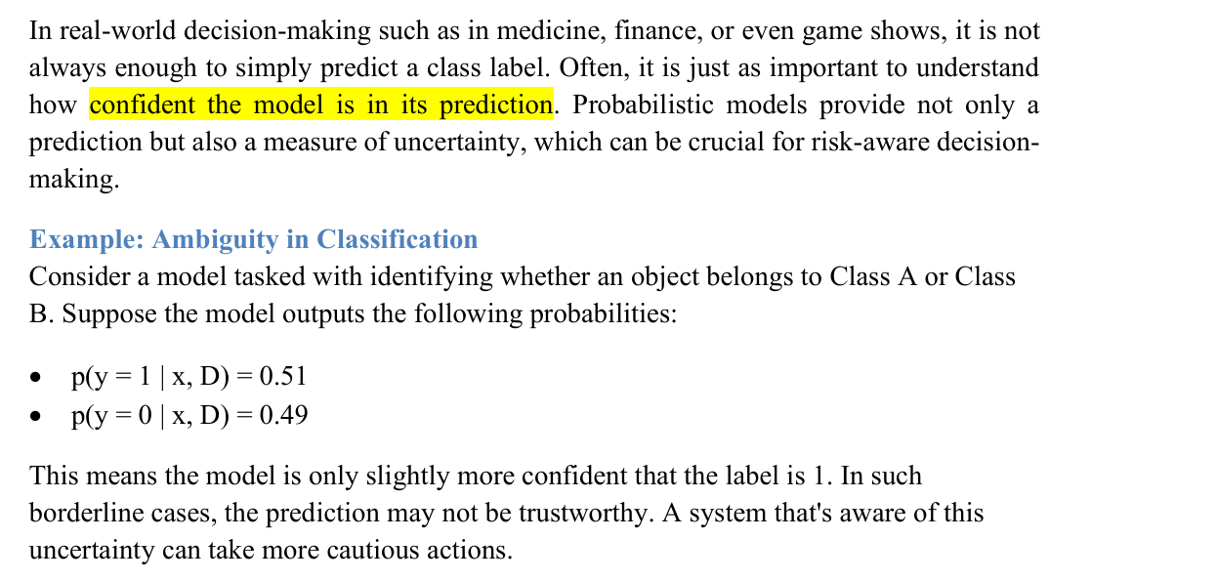
Supervised Learning-Classification

Slide 3
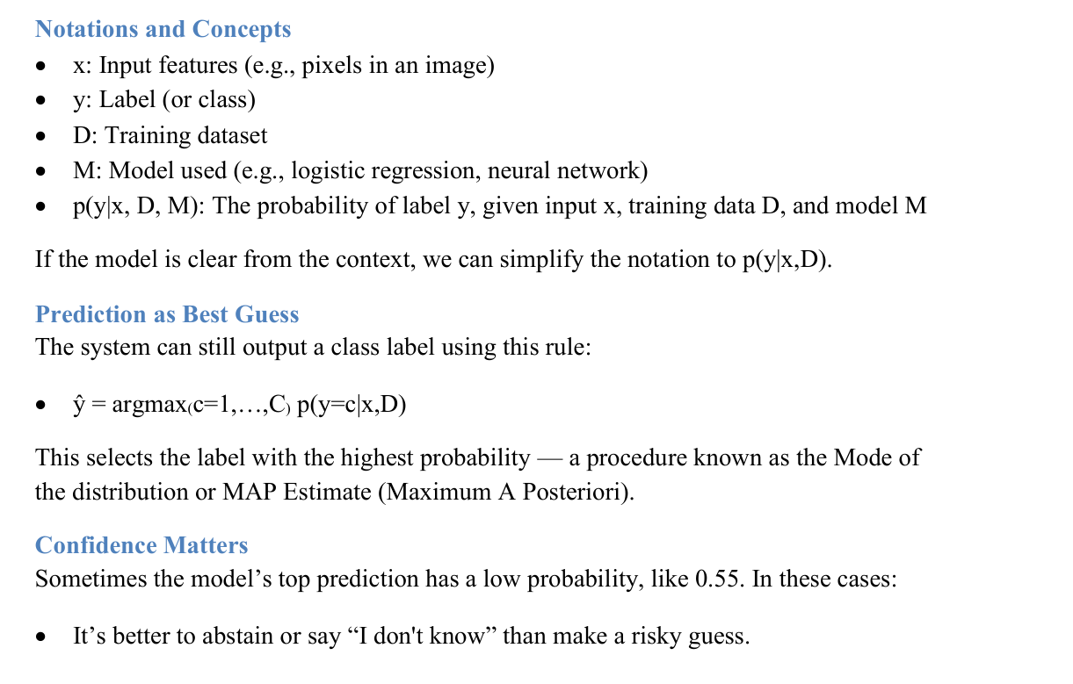

Slide 4
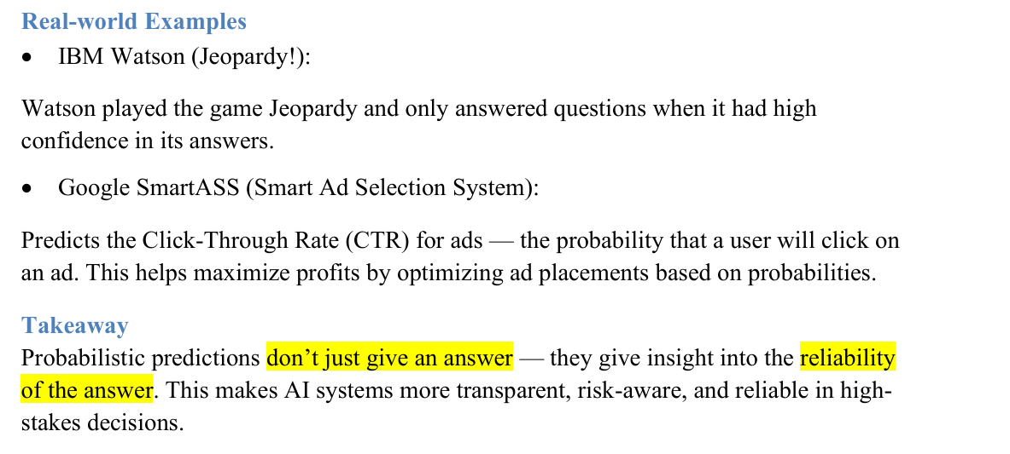

Slide 5
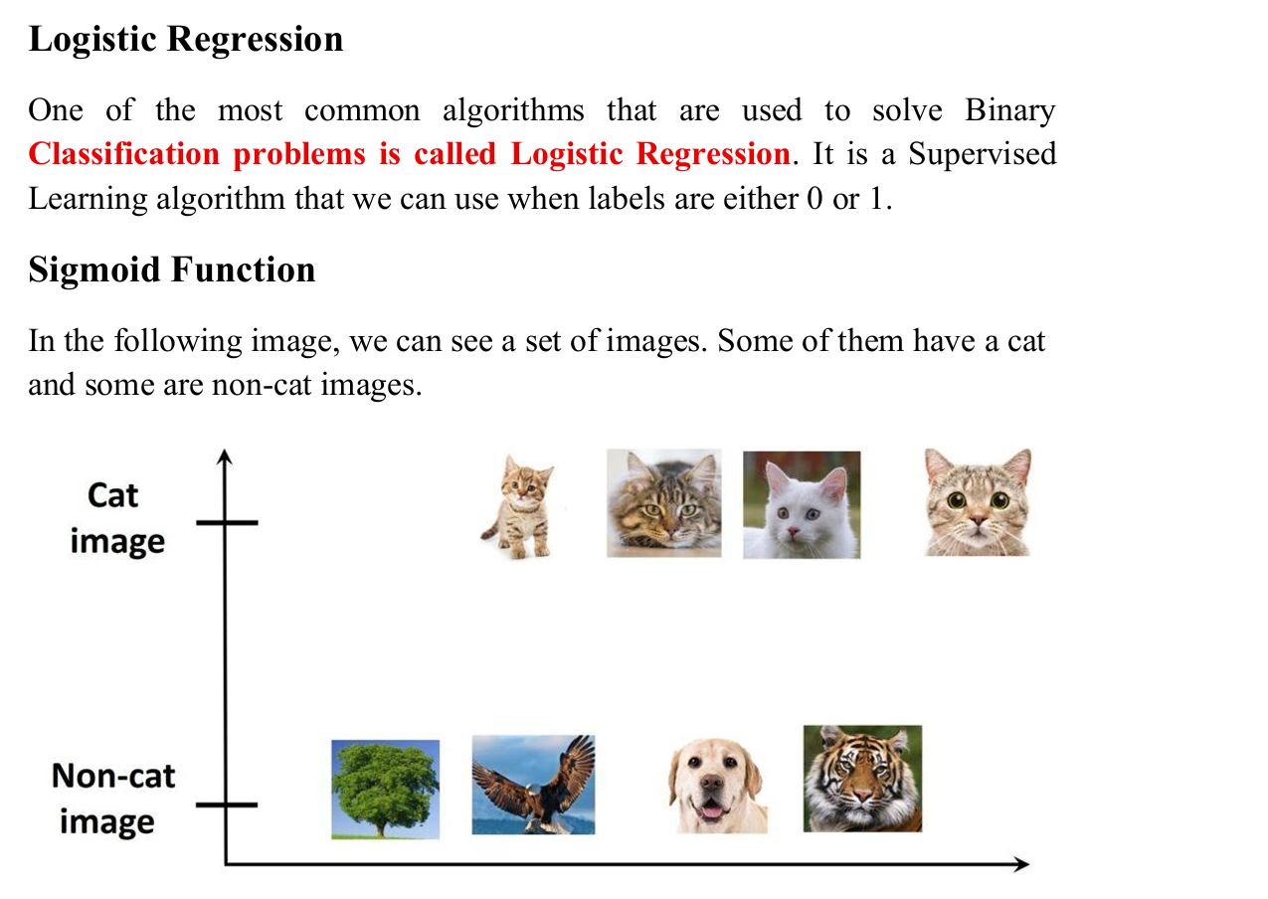

Slide 6
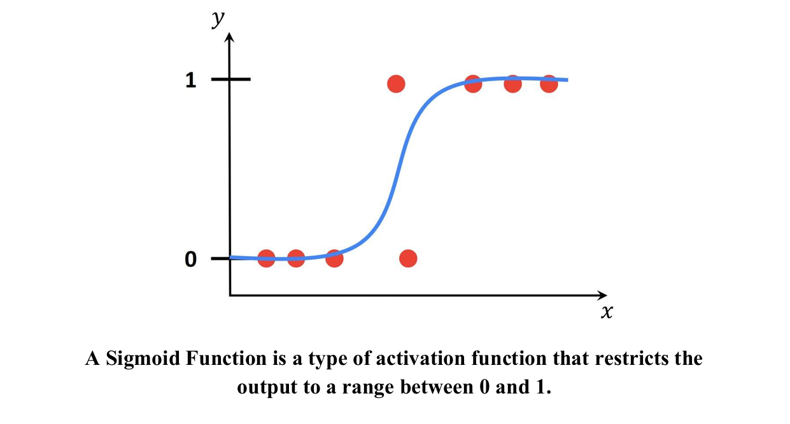

Slide 7
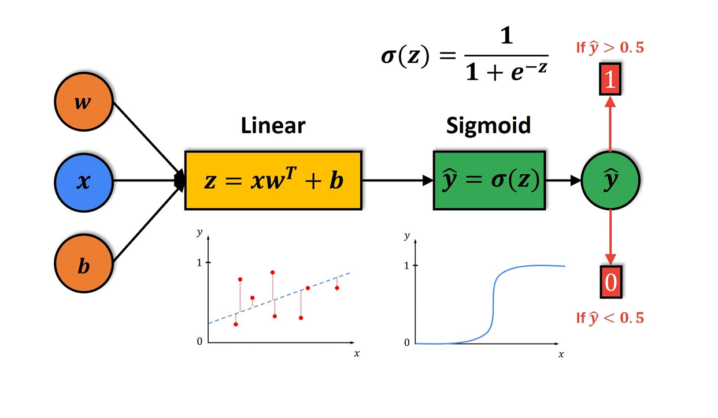

Slide 8
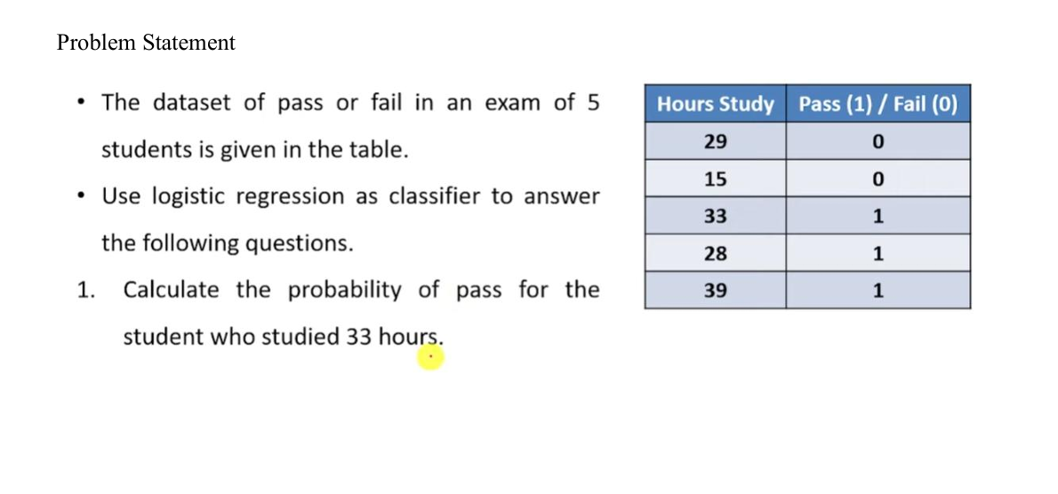

Slide 9
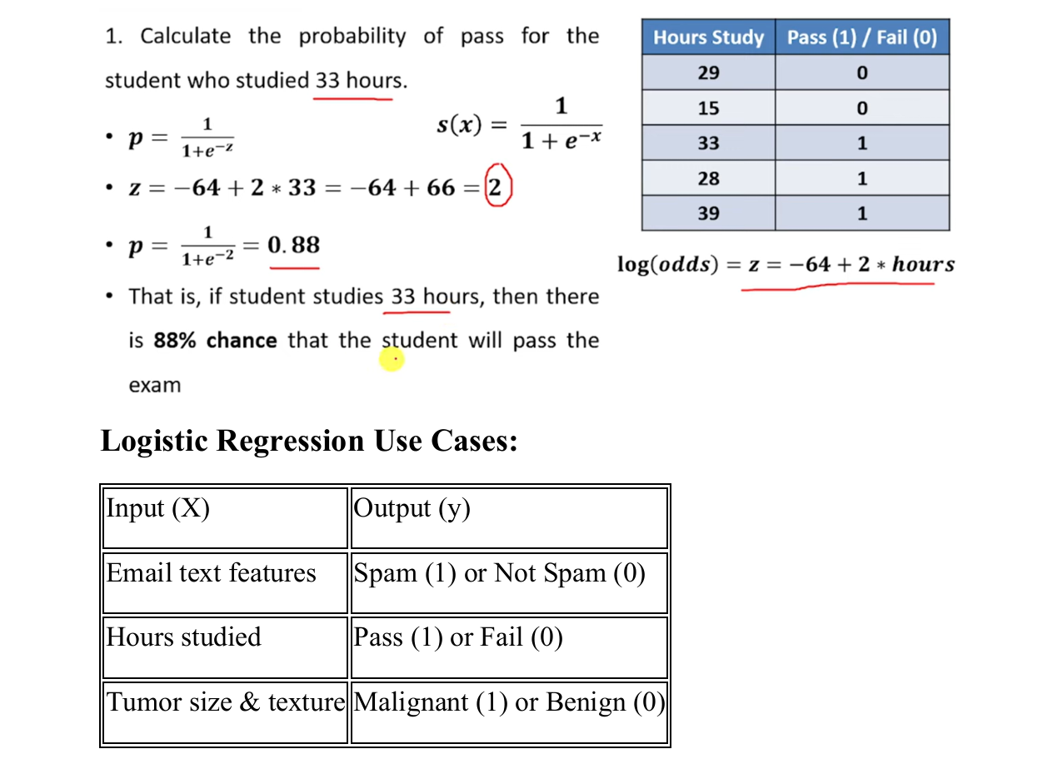

Slide 10
Bayes Classification Methods
Naive Bayesian classifiers assume that the effect of an attribute value on a given class is independent of the values of the other attributes.
This assumption is called class conditional independence.
It is made to simplify the computations involved and, in this sense, is considered “naive.”

Slide 11
Bayes’ Theorem
Bayes’ theorem is named after Thomas Bayes, a nonconformist English clergyman who did early work in probability and decision theory during the 18th century.
Let X be a data tuple.
In Bayesian terms, X is considered “evidence.”
Let H be some hypothesis such as that the data tuple X belongs to a specified class C.
For classification problems, we want to determine P(H|X), the probability that the hypothesis H holds given the “evidence” or observed data tuple X.
In other words, we are looking for the probability that tuple X belongs to class C, given that we know the attribute description of X.

Slide 12
Bayes’ Theorem
P(H|X) is the posterior probability, or a posteriori probability, of H conditioned on X.
For example, suppose our world of data tuples is confined to customers described by the attributes age and income, respectively, and that X is a 35-year-old customer with an income of $40,000.
Suppose that H is the hypothesis that our customer will buy a computer.
Then P(H|X) reflects the probability that customer X will buy a computer given that we know the customer’s age and income.

Slide 13
Bayes’ Theorem
In contrast, P(H) is the prior probability, or a priori probability, of H.
For our example, this is the probability that any given customer will buy a computer, regardless of age, income, or any other information, for that matter.
The posterior probability, P(H|X), is based on more information (e.g., customer information) than the prior probability, P(H), which is independent of X.
Similarly, P(X|H) is the posterior probability of X conditioned on H.
That is, it is the probability that a customer, X, is 35 years old and earns $40,000, given that we know the customer will buy a computer.

Slide 14
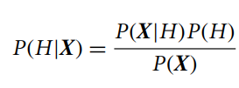
Bayes’ Theorem
P(X) is the prior probability of X.
Using our example, it is the probability that a person from our set of customers is 35 years old and earns $40,000.
“How are these probabilities estimated?”
P(H), P(X|H), and P(X) may be estimated from the given data.
Bayes’ theorem is useful in that it provides a way of calculating the posterior probability, P(H|X), from P(H), P(X|H), and P(X).
Bayes’ theorem is

Slide 15
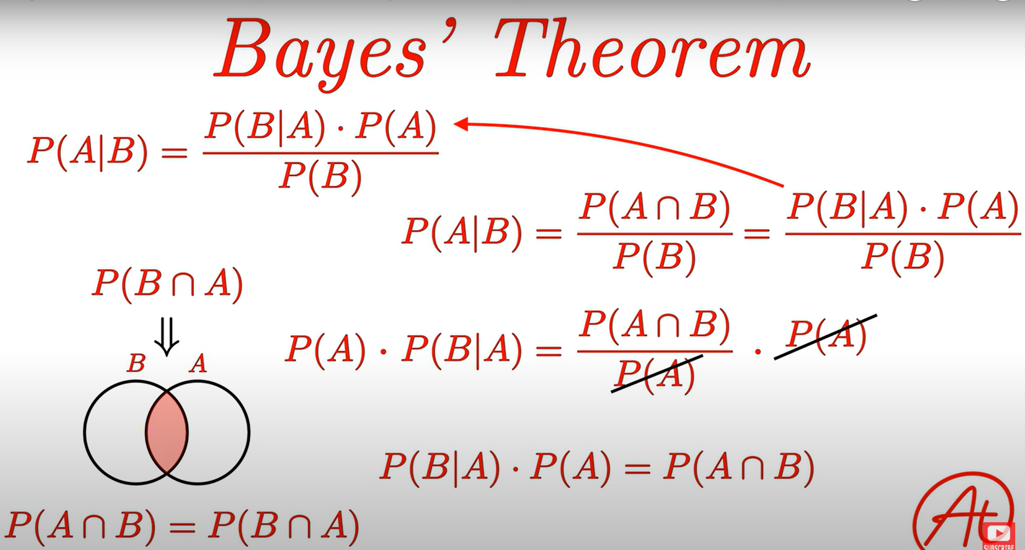
Derivation

Slide 16
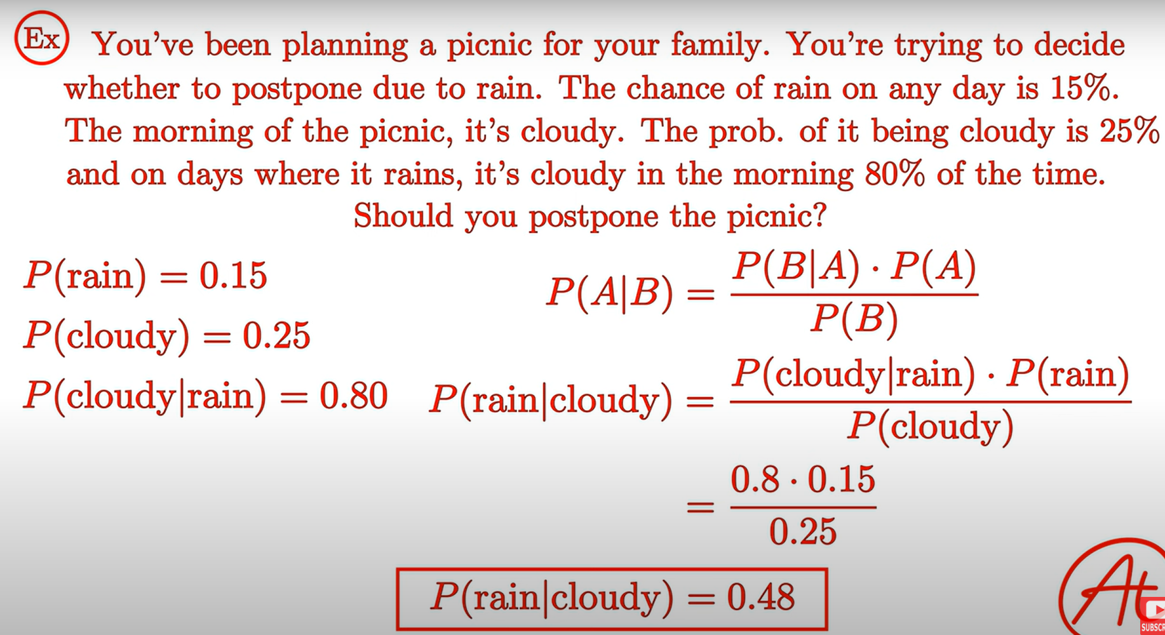

Slide 17
Problem
Suppose we know from statistical data that flu causes fever in 80% of cases, approximately 1 in
10,000 people have flu at a given time and approximately 1 out of every 50 people is suffering from
fever: Given
P(fever/flu)=0.8
P(flu)=0.0001
P(fever)=0.02
Given a patient with fever, does she have flu? Answer by applying Bayes rule:
Solution:
P(flu/fever)=[P(fever/flu).P(flu)]/P(fever)
=0.8X0.0001/0.02=0.004

Slide 18
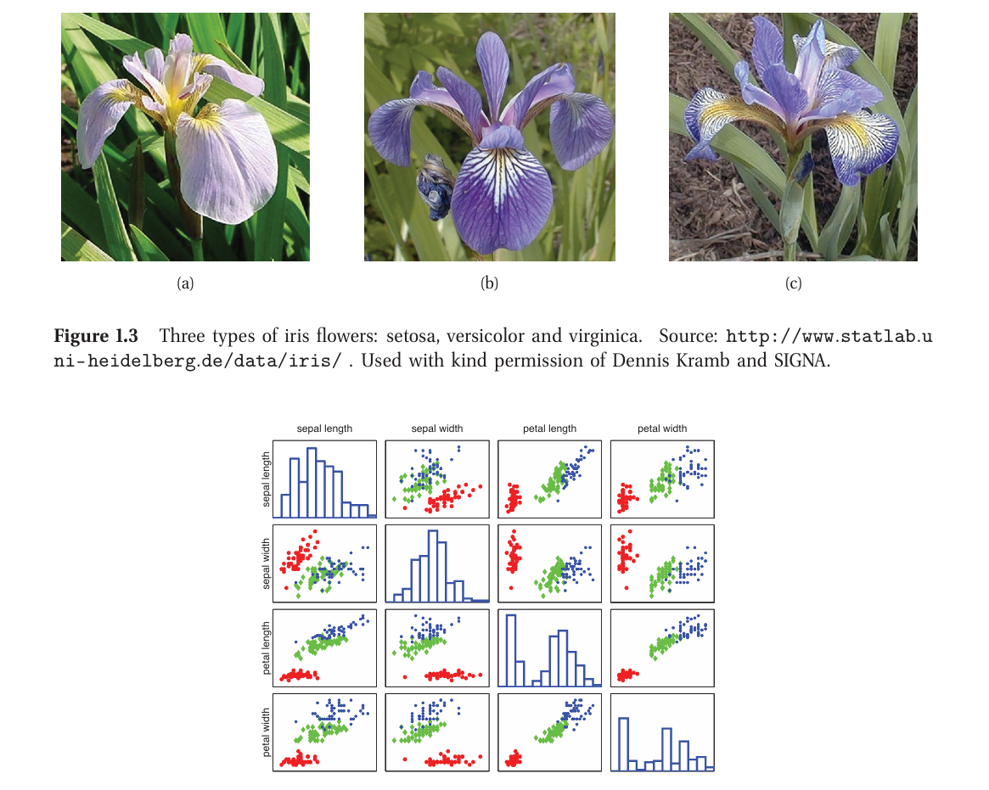
Real World Applications
Document classification
and email spam filtering
Classifying flowers

Slide 19
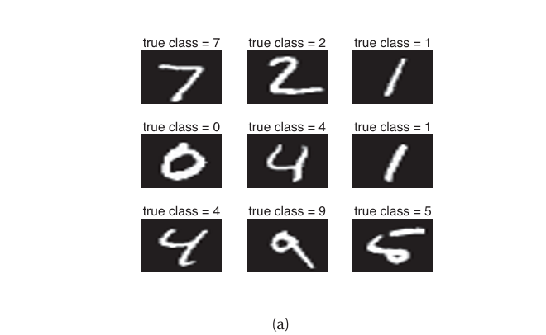
Digits Recognition

Slide 20
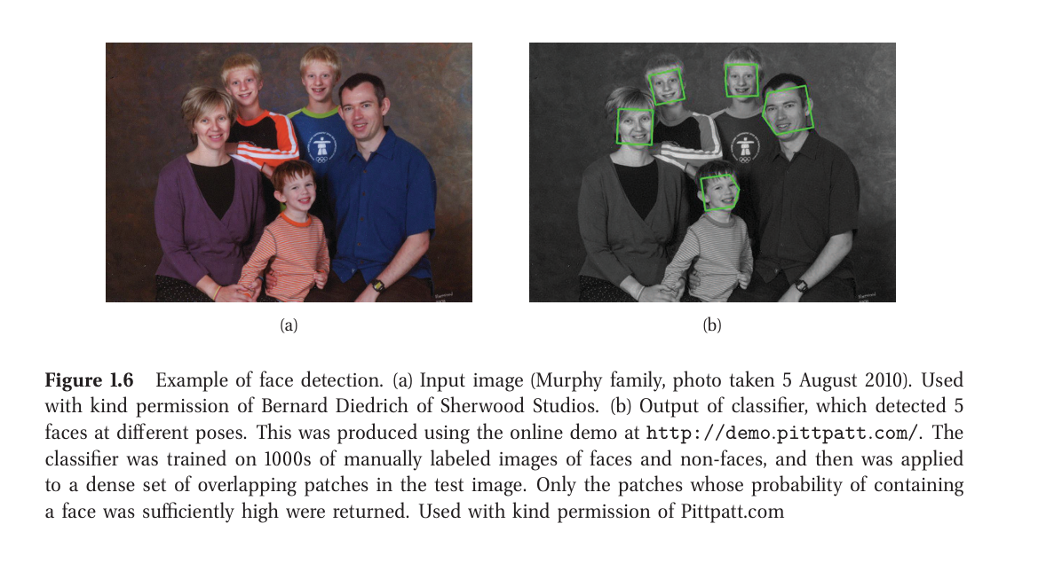
Face Detection and Recognition
Technical Insight:
Detection = "Is there a face?"
Recognition = "Whose face is it?"

Slide 21
Face Detection
It is a special case of object detection/localization.
The image is divided into small overlapping patches (various scales, positions, orientations).
Each patch is classified as face or non-face using a sliding window detector.
Probabilities are computed to determine if a patch contains a face.
Applications:
Built into modern digital cameras for auto-focus based on detected face locations.
Used in Google Street View to blur faces for privacy.

Slide 22
Face Recognition:
Goal: Identify the person after detecting the face.
The number of possible identities (class labels) can be very large.
Different features are important than in detection:
Recognition focuses on subtle variations (e.g., hairstyle, facial structure).
Detection focuses on common face characteristics, invariant to small differences.
Recognition is a harder problem than detection.

Slide 23
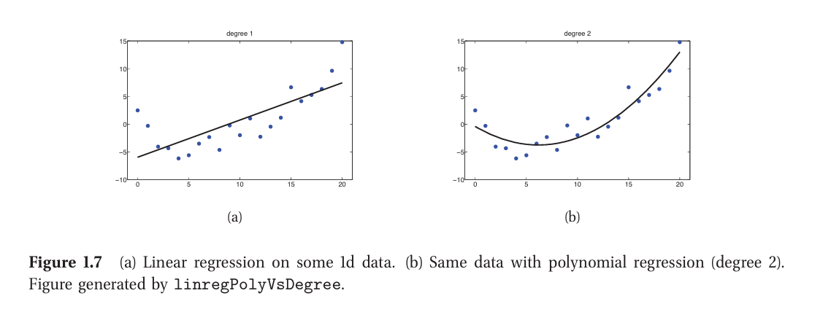
Regression
Regression is just like classification except the response variable is continuous.

Slide 24
Here are some examples of real-world regression problems.
Predict tomorrow’s stock market price given current market conditions and other possible side information.
Predict the age of a viewer watching a given video on YouTube.
Predict the location in 3d space of a robot arm end effector, given control signals (torques) sent to its various motors.
Predict the amount of prostate specific antigen (PSA) in the body as a function of a number of different clinical measurements.
Predict the temperature at any location inside a building using weather data, time, door sensors, etc

Slide 25
Unsupervised learning
Clustering (e.g., grouping people by height and weight).
Dimensionality Reduction: PCA, ICA (used in genetics, NLP).
Graph Structure Discovery: Learning connections (e.g., in protein networks or finance).
Matrix Completion: Filling missing data (Netflix movie ratings, image inpainting).

Slide 26
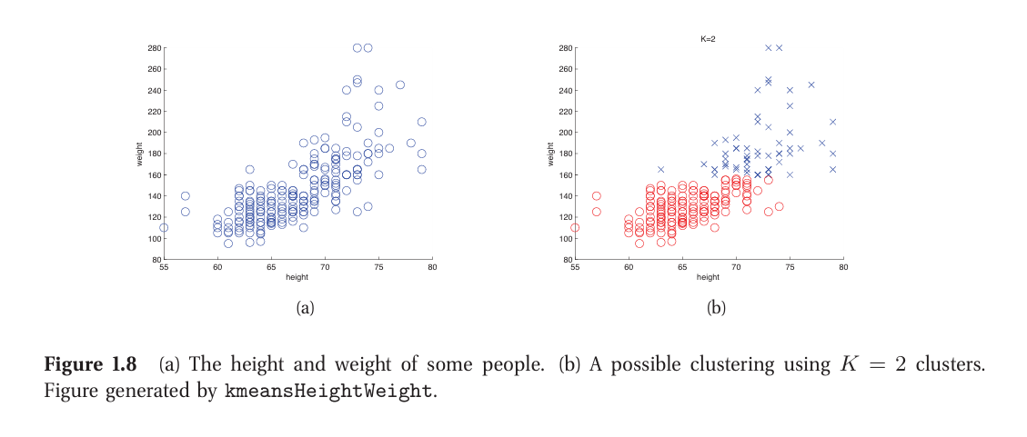

Slide 27
What is Dimensionality Reduction?
Technique to reduce high-dimensional data into a lower-dimensional subspace.
Goal: Capture the “essence” or most informative structure in the data.
Example: Projecting 3D data into 2D (Figure 1.9), giving a good approximation.
Projecting into 1D loses too much information → poor approximation.

Slide 28
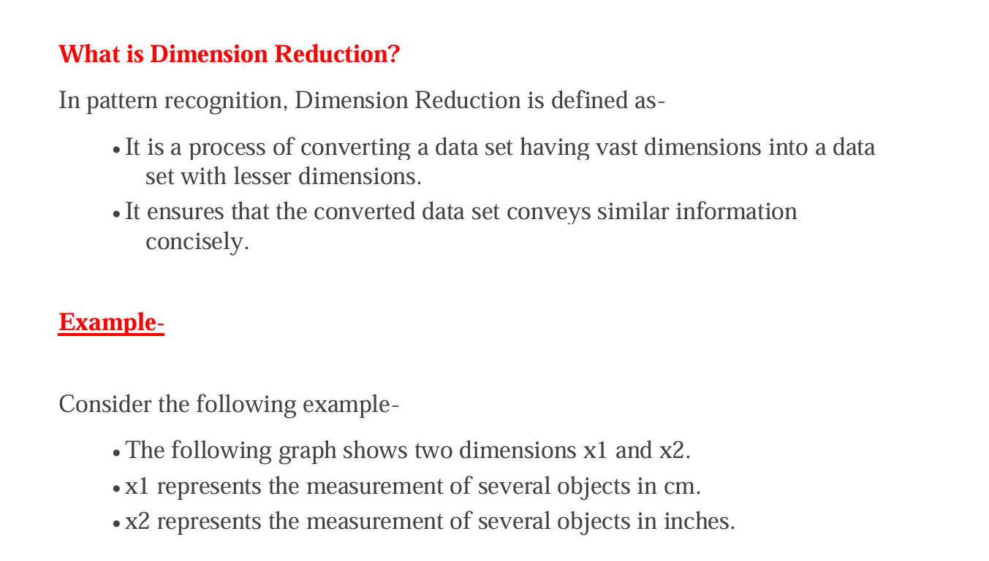
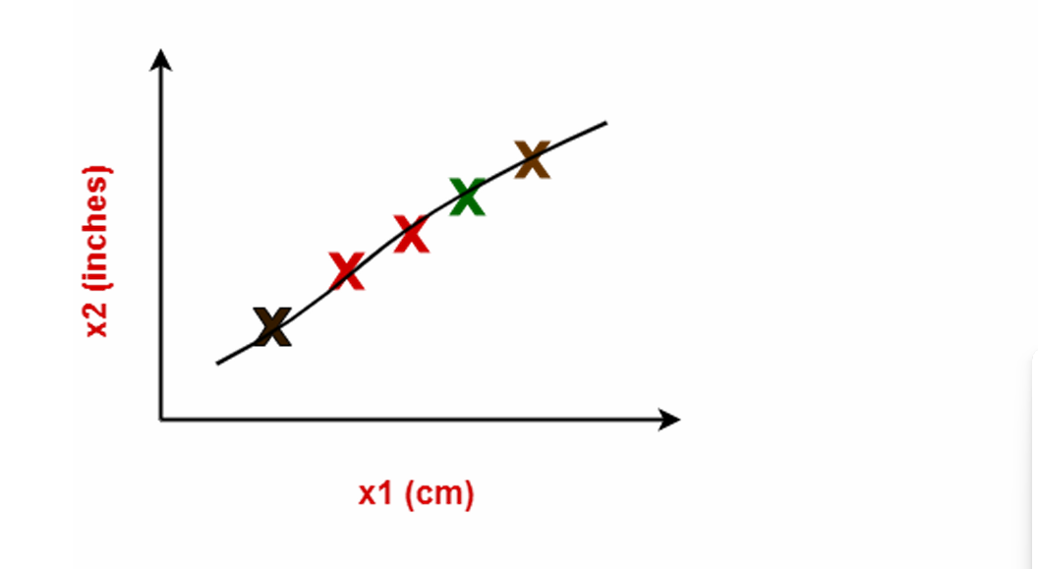

Slide 29
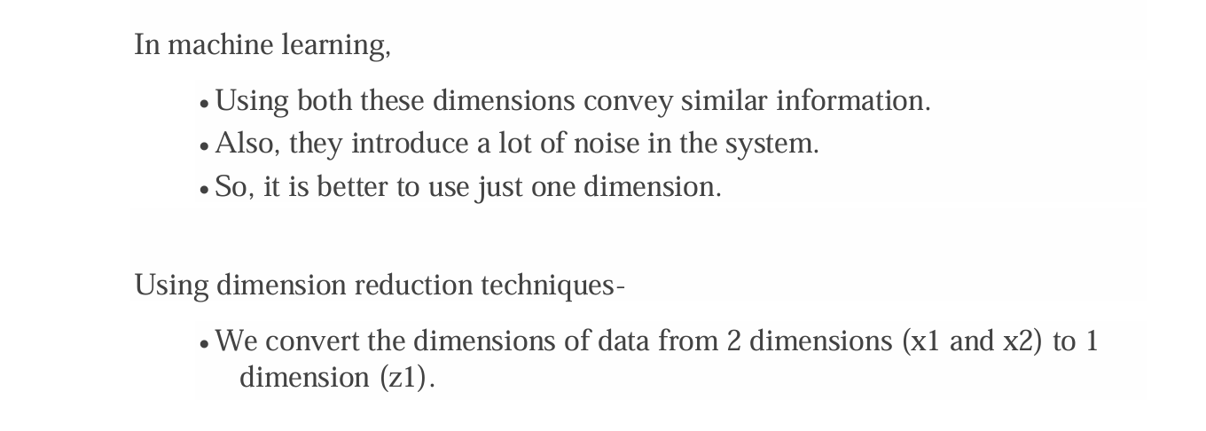
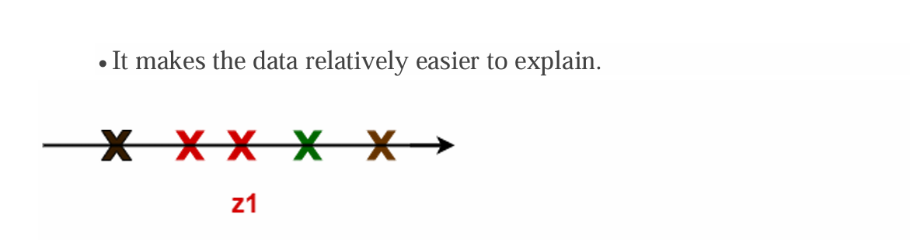

Slide 30
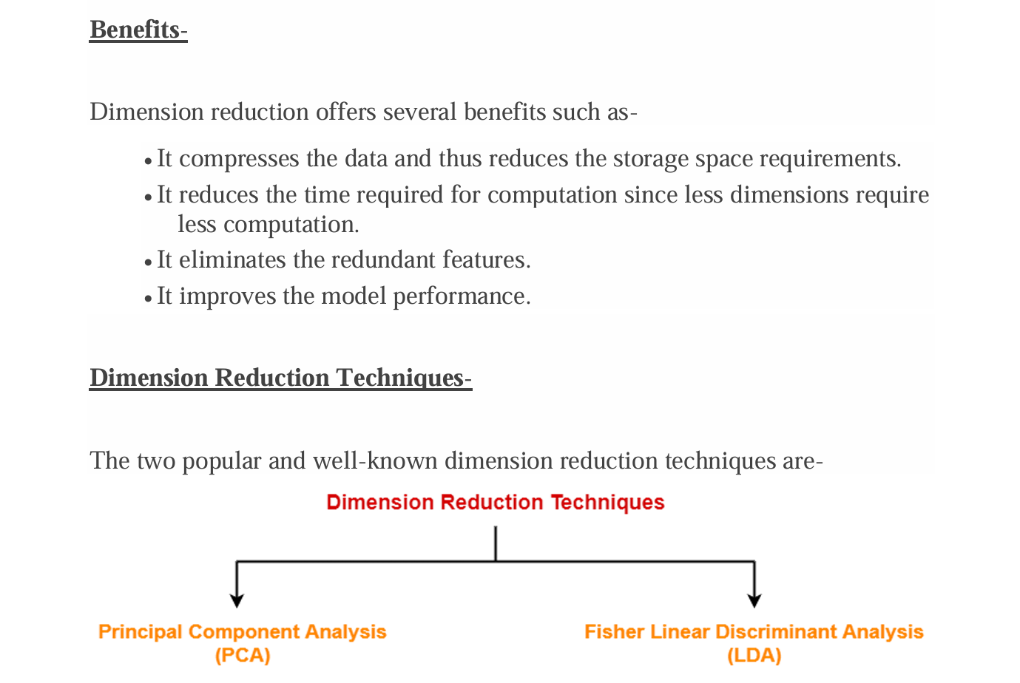

Slide 31
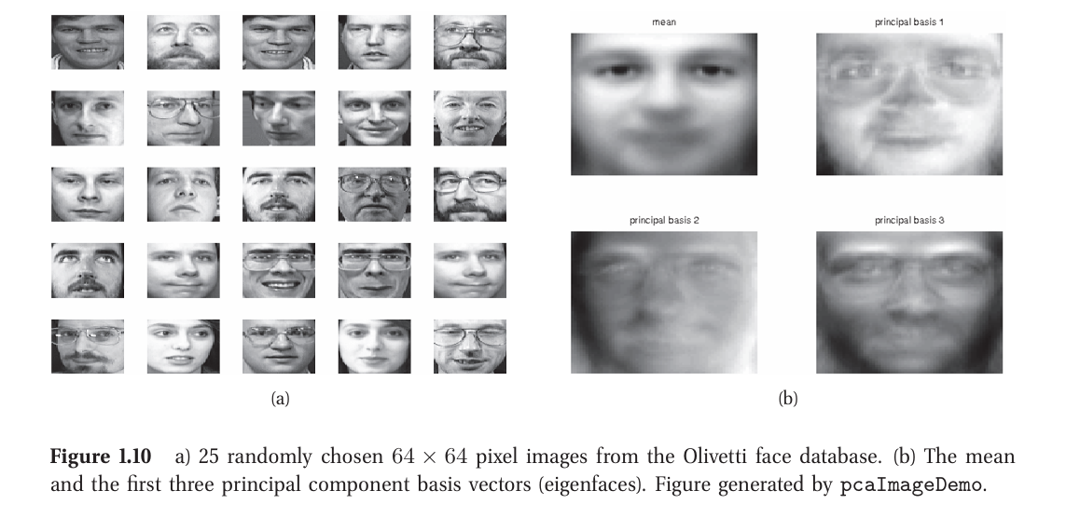
Latent Space

Slide 32
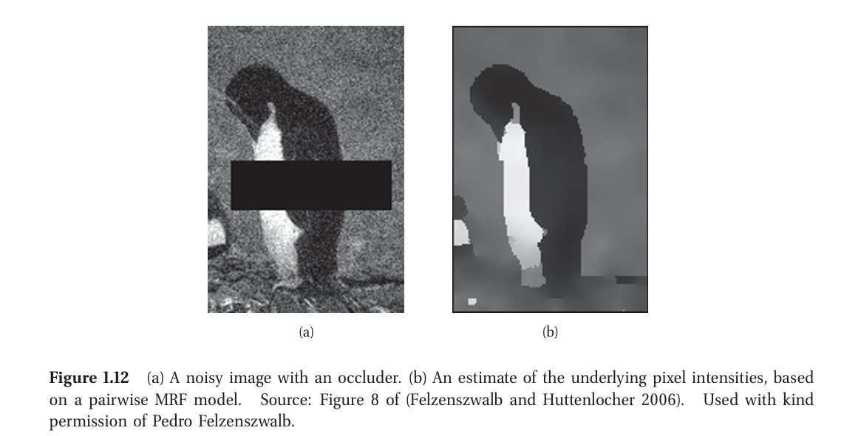
Image inpainting

Slide 33
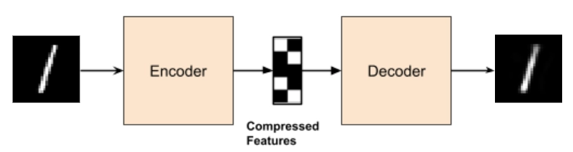
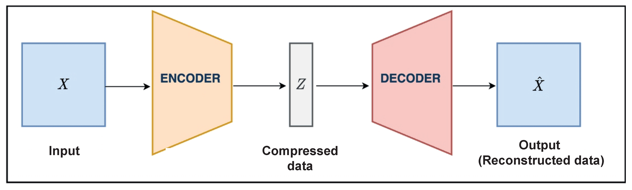

Slide 34
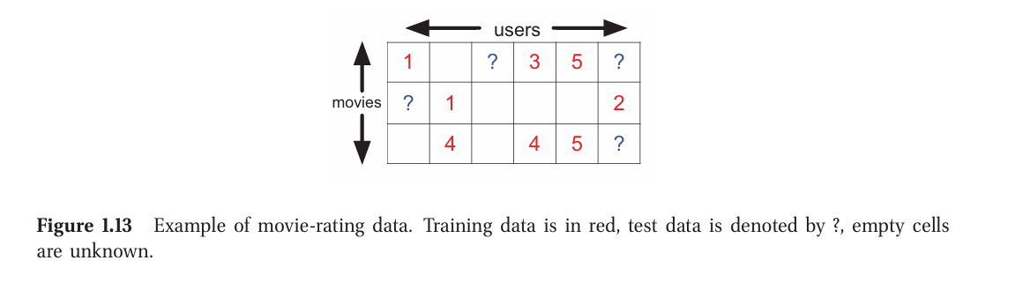
Collaborative filtering

Slide 35
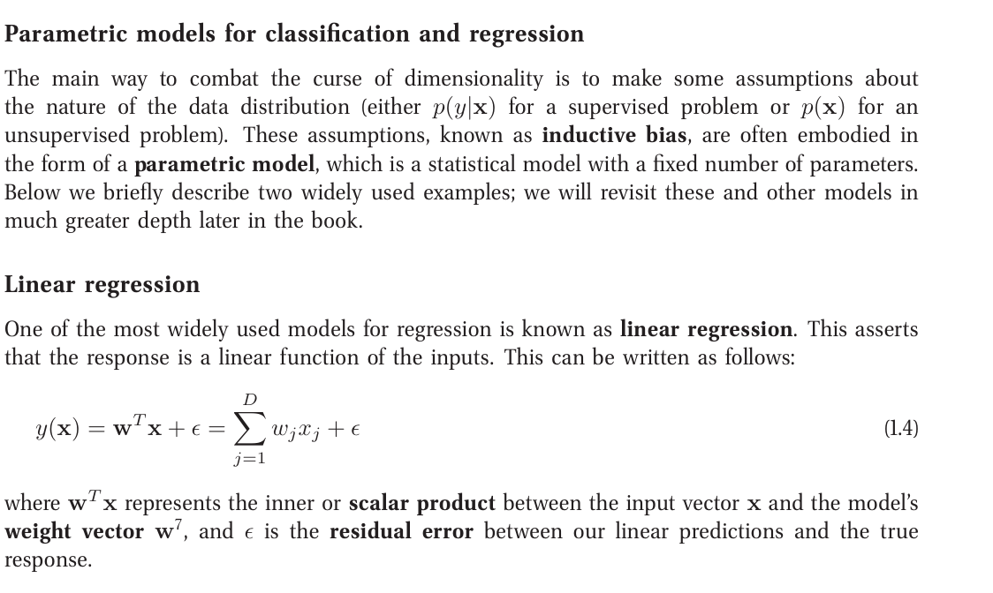
Parametric vs non-parametric models

Slide 36
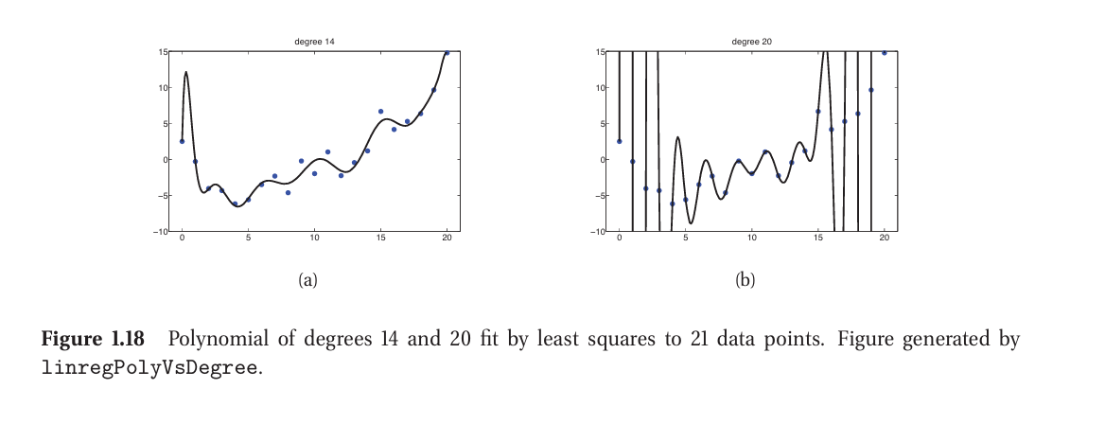

Slide 37
Non-Parametric
Non-parametric models do not assume a fixed number of parameters.
The model grows with the data — more data means more complexity.
They are flexible and can model complex patterns.
However, they can be computationally expensive for large datasets.

Slide 38
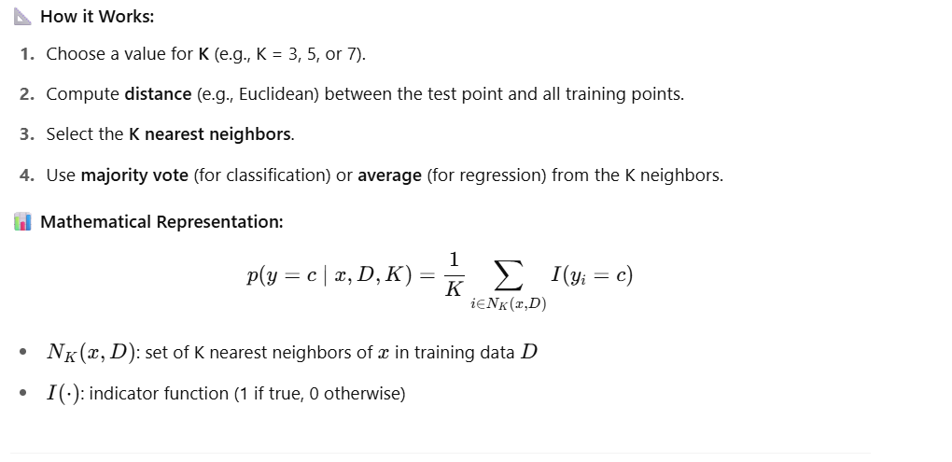
K-Nearest Neighbors (KNN) – A Classic Non-Parametric Classifier

Slide 39
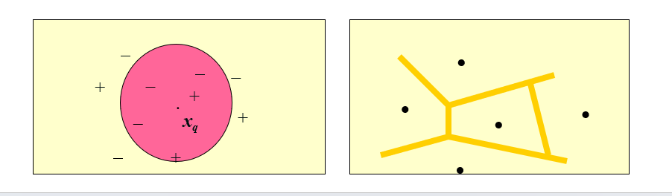

Slide 40
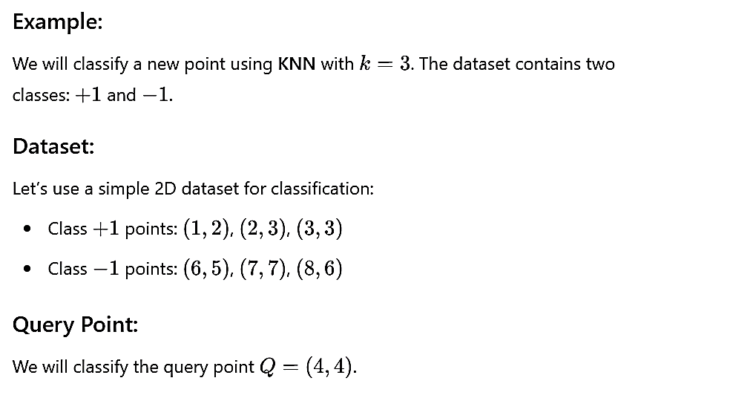
Lazy Classifier- KNN
k-nearest neighbor approach
Instances represented as points in a Euclidean space.

Slide 41
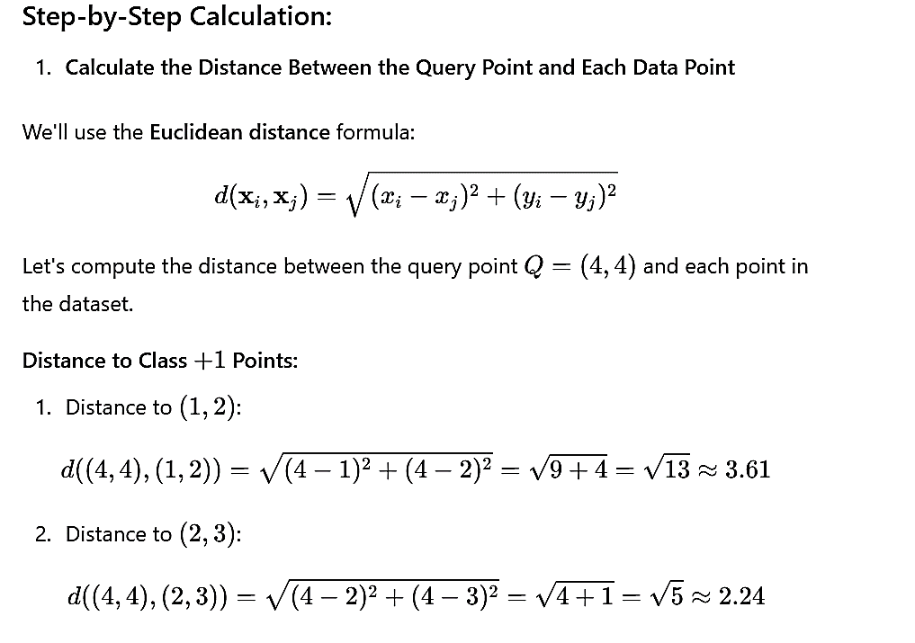

Slide 42
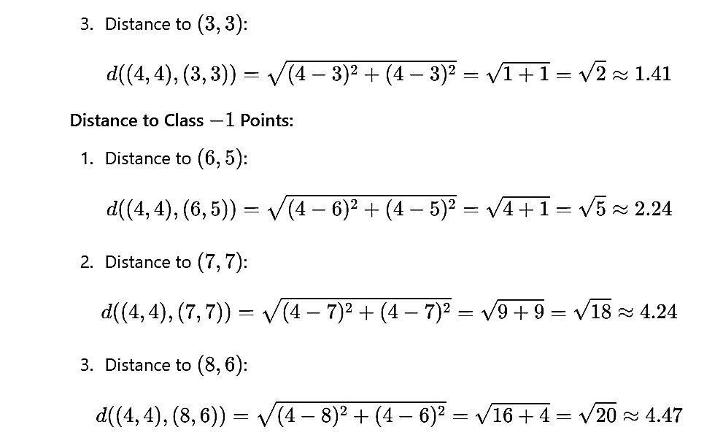

Slide 43
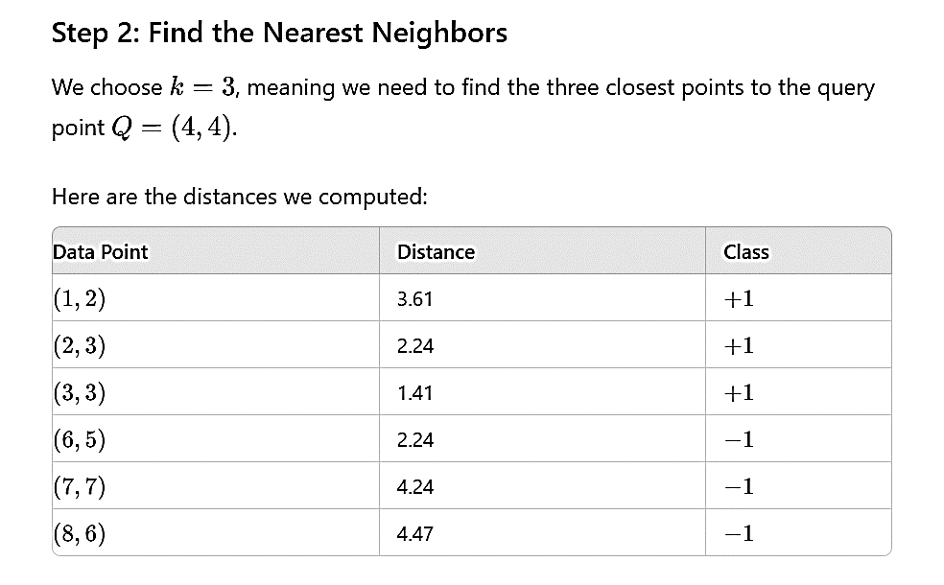

Slide 44
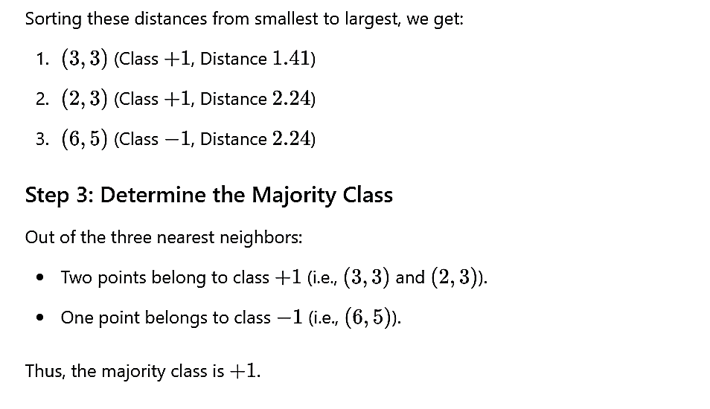

Slide 45
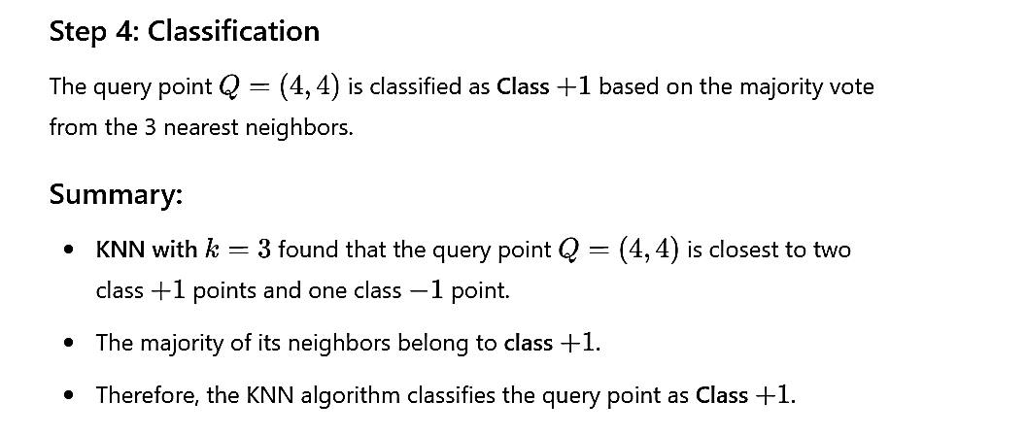

Slide 46
